Slide 1
accessibility and usability
Work made by: Jesús Arencibia Falcón

Slide 2

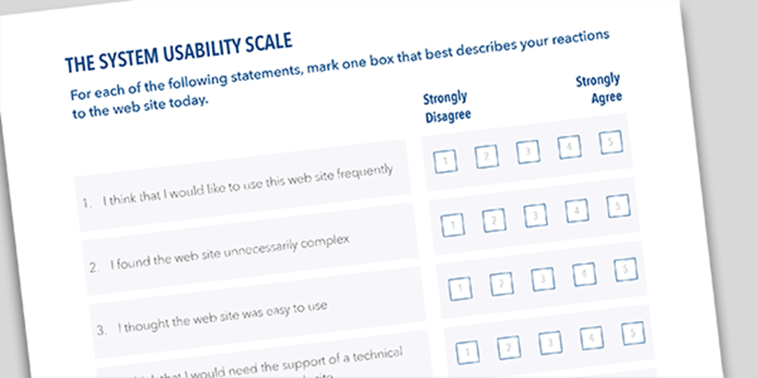
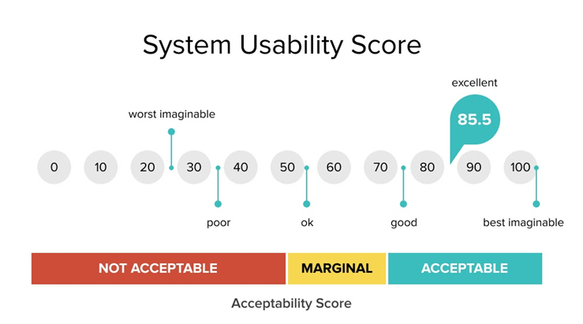


The System Usability Scale (SUS)
The System Usability Scale (SUS) was invented by John Brooke who, in 1986, created this ‘quick and dirty’ usability scale to evaluate practically any kind of system. The SUS has been tried and tested throughout almost 30 years of use and has proven itself to be a dependable method of evaluating the usability of systems compared to industry standards.

Slide 3
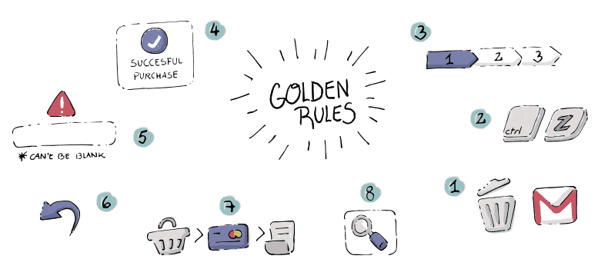
The Eight Golden Rules
Ben Shneiderman is the author of these 8 rules, and he is an American scientist with a strong expertise in the field of human-machine interaction. Eight golden rules are intended to help designers solve problems, and for this purpose Shneiderman offers them significant help with his eight heuristics. In order to improve usability, an interface needs to be well designed to be "user-friendly".

Slide 4


two different websites
https://www.amazon.es/
https://www.ebay.es/

Slide 5
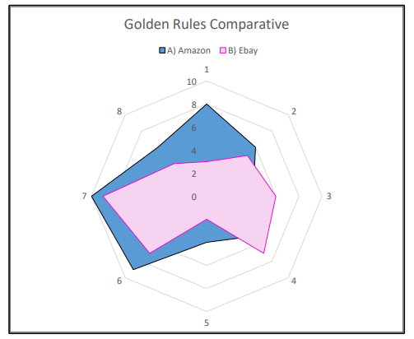
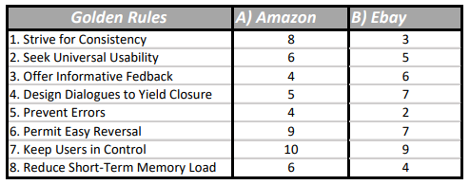
GolDen rules Comparative

Slide 6
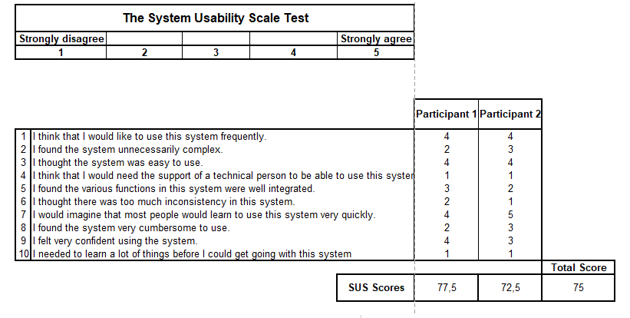
Amazon Website SUS

Slide 7
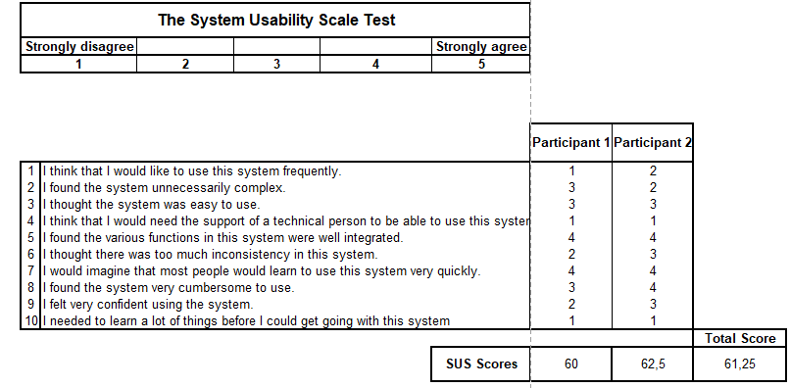
EBay Website SUS

